Slide 1
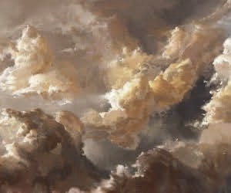
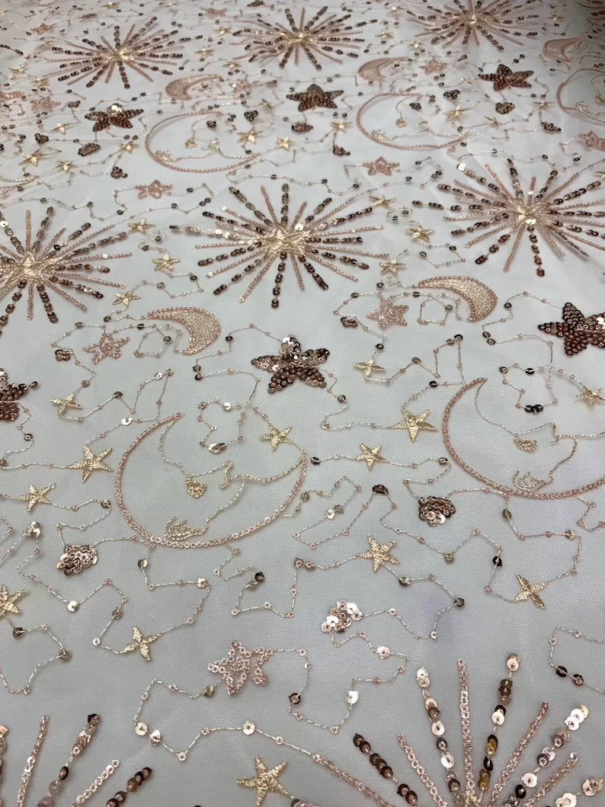
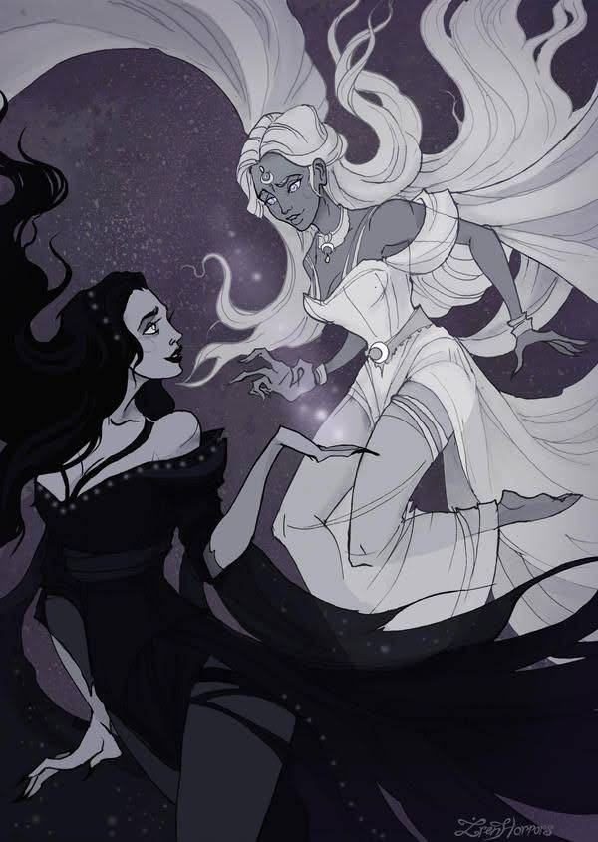


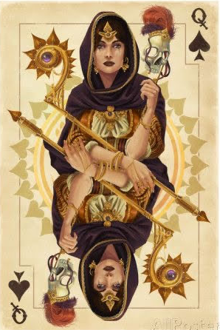
Lucid Dream
Asteria
Goddess of Dreams & Astrology

Slide 2

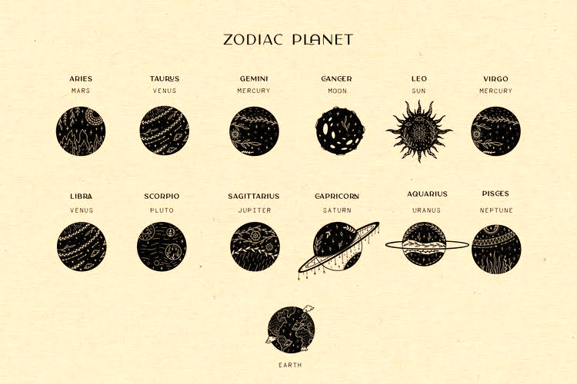
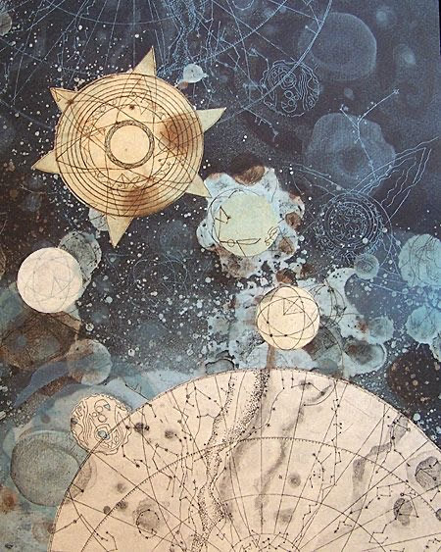
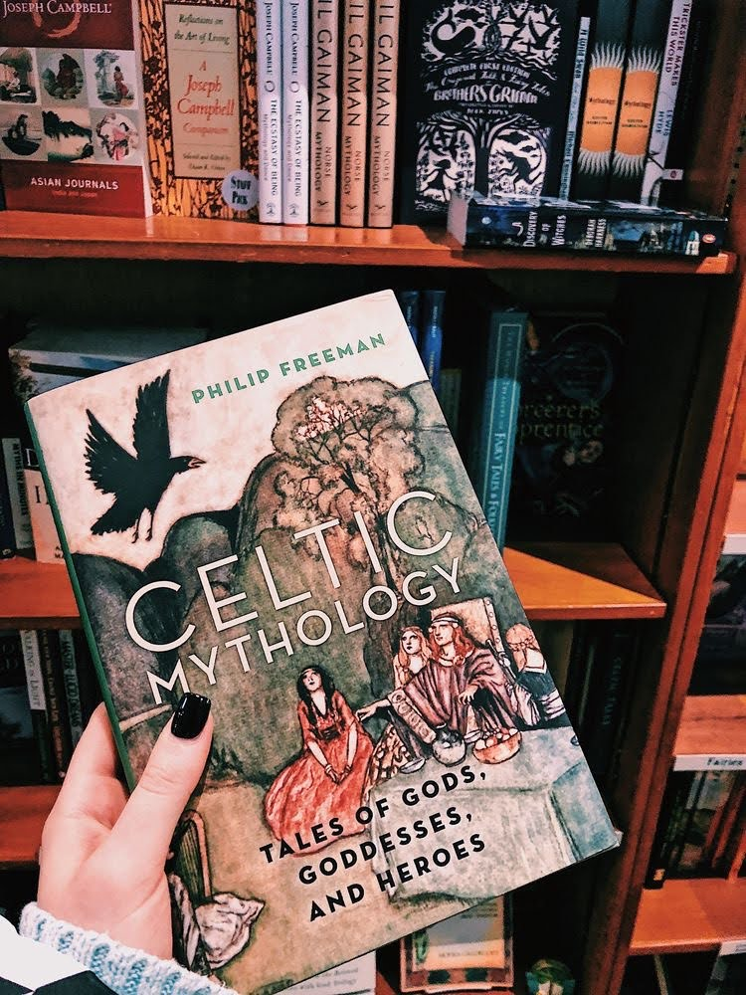
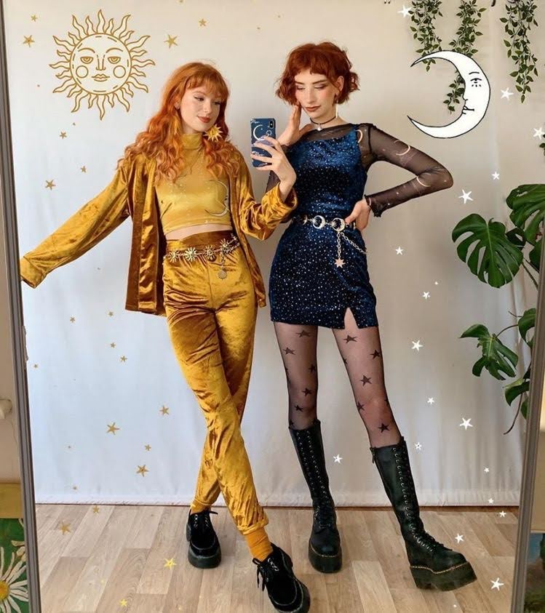
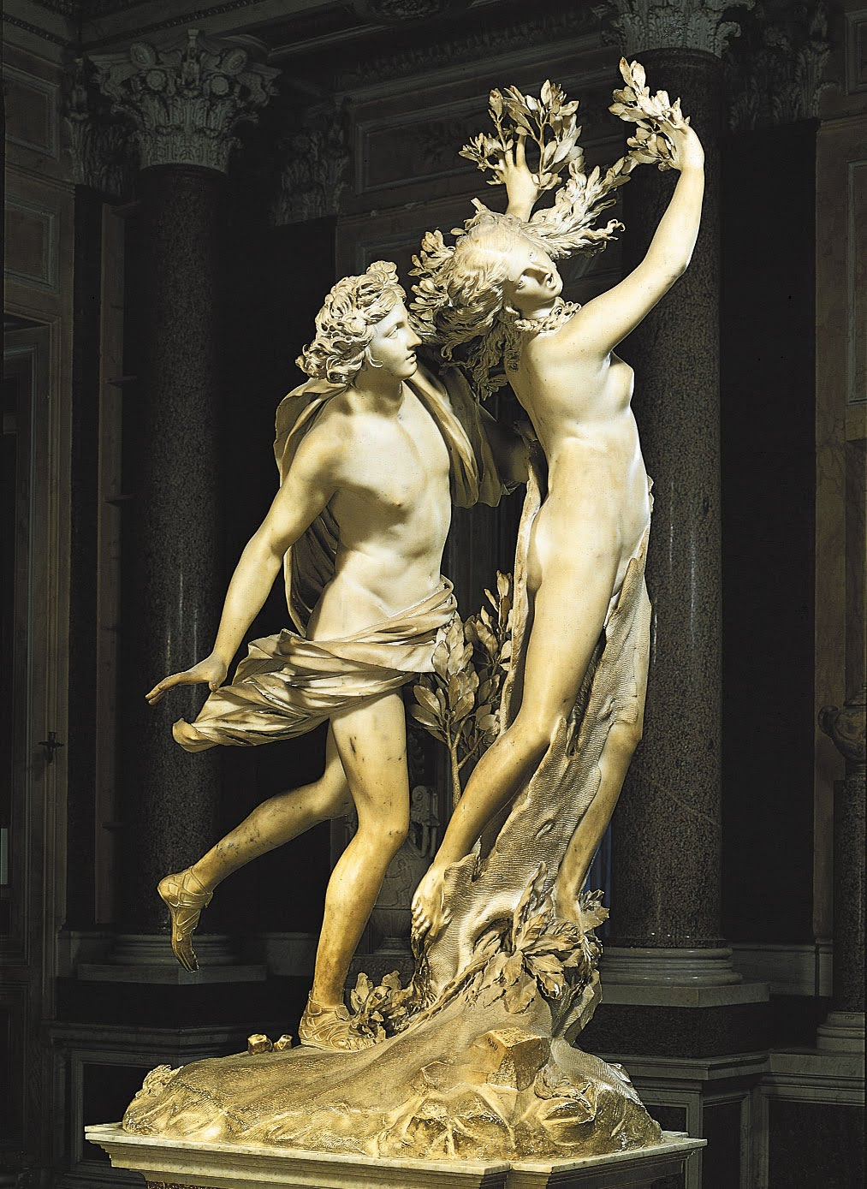
Customer Profile
Name: Cassandra
Age: 22
Major: Philosophy
Name: Aurora
Age: 23
Major: History of Art

Slide 3
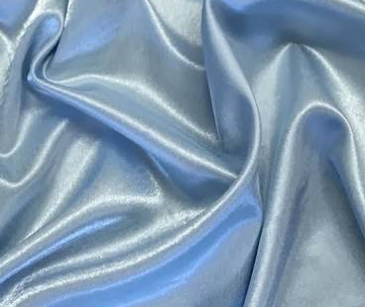

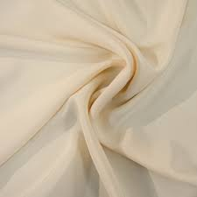

Satin
Fabric & Materials Board
Sateen
Crepe De Chine
Tulle

Slide 4
Designs

Slide 5
Designs

Slide 6
Designs

Slide 7
Front

Slide 8
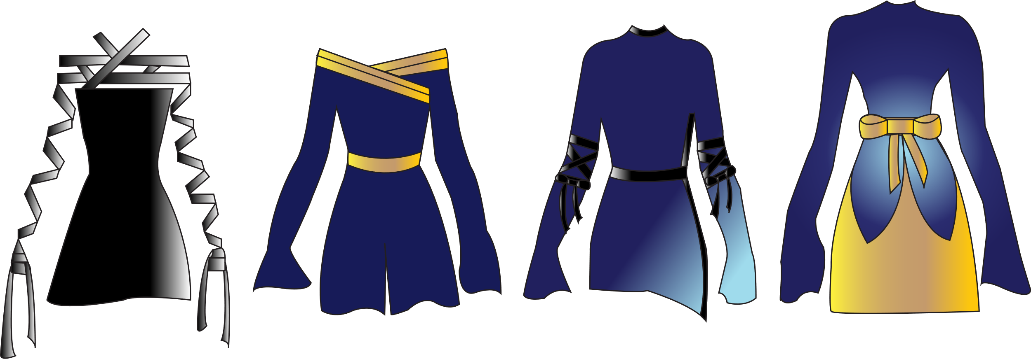
Back

